Slide 1
Course Outline
Anh Nguyen-Duc
Tho Quan-Thanh
WEEK 1

Slide 2
Aims
The goal of this course is to provide undergraduate students with
Knowledge (concepts, terms, processes, models)
Skill (methods, techniques)
for requirement, analysis, design, implementation and testing of software-intensive systems.
Notes:
Aims:
The goal of this course is to provide undergraduate students with techniques, methods and processes for the development of software-intensive systems.

Slide 3






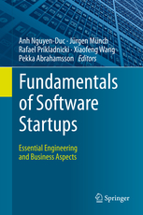
Anh Nguyen-Duc
Academic experience:
Assc. Prof. in University of South Eastern Norway
Dr. in Experimental Software Engineering
Academic services:
Vice chair of Software Startup Research Network
Co-Founder of VietSE – Vietnamese Software Engineering Network
Steering member NOKOBIT (Norsk konferanse for organisasjoners bruk av informasjonsteknologi)
Co-chairs of NOKOBIT 2020, ICSOB 2019, IWSS 2018, 2017, PROFES 2016, ICE 2016
Book author – Fundamentals of Software Startups
Guest editors & PCs in 20+ SE conferences and journals
Research interests:
Software Startups
Lean Startup Education
Global Software Development
Security in Internet-of-things
Email: angu@usn.no
3

Slide 4
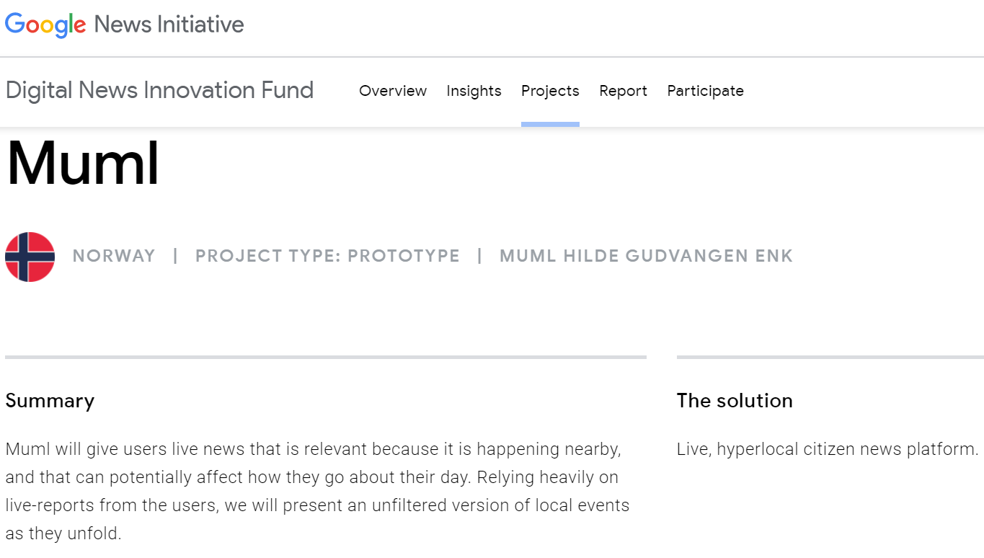






Anh Nguyen-Duc
Teaching:
WEB6101N - Web Development and Human User Interaction (2017-2020), USN
TDT4920 - Customer Driven Projects (2011-2020), NTNU
Green IT (expected Autumn 2021), USN
MIS405 - Managing IT Projects (Spring 2020,2021), USN
Practical Project Management (Spring 2018-2020), USN
SYS1000B - Software Engineering (Spring 2018), USN
TDT4140 - Software Engineering, (2016-2017), NTNU
Entrepreneur:
2015: Muml – Hyper-local news platform
2019: VVN – eKYC solution
IT & Startup consultancy
4

Slide 5
Menti.com
Write the first three words coming to your mind when hearing “software engineering” / công nghệ phần mềm

Slide 6
Outline
An introductory course to the field of software engineering.
The goal is to provide techniques, methods and processes for the development of software-intensive systems.
Help getting familiar with software engineering activities: requirements elicitation, software specification, architectural & detailed design using design patterns.
Also cover software implementation and software testing
Use extensively the UML modeling language
Notes:
Course outline:
This is an introductory course to the field of software engineering. The goal of this course is to provide undergraduate students with techniques, methods and processes for the development of software-intensive systems. They will get familiar with various engineering activities for software development including requirements elicitation, software specification, architectural & detailed design using design patterns, implementation, and software testing. The UML modeling language is extensively used in the course.

Slide 7
Student learning outcomes
Knowledge:
L.O.1. Understand that software systems need to be developed methodologically and professionally;
L.O.2. Elicit requirements & perform architectural design;
Competence:
L.O.3. Cary out detailed design, coding, testing;
L.O.4. Use the UML language effectively in software development.
Notes:
Learning outcomes:
Upon completing this course, a learner shall be able to: (1) Understand that software systems need to be developed methodologically and professionally; (2) Elicit requirements & perform architectural design; (3) Carry out detailed design, coding, testing; and (4) Use the UML language effectively in software development.

Slide 8
Student learning outcomes
No. | Course learning outcomes
L.O.1 | Understand that software systems need to be developed methodologically and professionally;
 | L.O.1.1 Understand principles and concepts of software engineering L.O.1.2 Understand methods and techniques of software engineering
L.O.2 | Elicit requirements & perform architectural design
 | L.O.2.1 Requirements elicitation L.O.2.2 Architectural design
L.O.3 | Cary out detailed design, coding, testing
 | L.O.3.1 Detailed design L.O.3.2 Coding L.O.3.3 Testing
L.O.4 | Use the UML language effectively in software development
 | L.O.4.1 UML use-case diagram L.O.4.2 UML sequence diagram L.O.4.3 UML class diagram L.O.4.4 UML activity diagram (or UML state-chart diagram)

Slide 9

Textbook/reference book
[1] Ian Sommerville (2015), Software Engineering (10th ed.), ISBN 978-0133943030, Pearson
[2] G. Booch, J. Rumbaugh, I. Jacobson (1998), The Unified Modeling Language User Guide, Addison-Wesley.
[3] E.J. Braude (2001), Software Engineering: An Object-Oriented Perspective, ISBN 978-0-471-32208-5, John Wiley.
[4] Gamma, E., Helm, R., Johnson, R., Vlissides, J., Design Patterns: Elements of Reusable Object-Oriented Software, ISBN 978-0201633610, AddisonWesley Professional (Nov. 10, 1994)
[5] State-of-the-art articles on Software Engineering

Slide 10
Teaching activities
Flipped classroom: read materials before the lectures
Rehearsal section
In-class activities
Student presentation
Capstone projects
Final exam

Slide 11
Evaluation
In-class/online activities/quizzes: 10%
Student presentation: 10%
Group-based project: 30%
Final writing exam: 50%

Slide 12
Quizzes
Online, every week. Two categories:
Before the lecture:
Read slides, prepare yourself and take the quizzes before the lecture.
The questions are simple, just review the content of the coming lecture.
After the lecture (named "... - advanced"):
Summarize the content of the lecture, give to cases for you to apply the knowledge of the lecture.
The questions are some more advanced. Take your time to reflect the lecture before taking the quizzes.
Duration limit of 10', valid in a few days.
You can take a quiz twice to get the highest score.
Please check the course website regularly

Slide 13
Project

Slide 14
Tentative schedulE
Wk | Tuần DL 2023 | Topic
1 | 35 | Ch1. Introduction
2 | 36 | Ch2. Software process
3 | 37 | Ch3. Req. engineering
4 | 38 | Ch4. Req. engineering (cont.)
5 | 39 | Ch5. Introduction to OPP (đọc thêm). Ch6. System modeling
6 | 40 | Ch5. Introduction to OPP (đọc thêm). Ch6. System modeling (cont.)
7 | 41 | Review Project #1
 | 42 | Midterm break
8 | 43 | Ch7. Architecture design
9 | 44 | Review Project #2
10 | 45 | Ch8. Design and Implementation
11 | 46 | Ch9. Quality assurance
12 | 47 | Review Project #3
13 | 48 | Ch10. Agile Software Development
14 | 49 | Student presentation (Task 5.2)
15 | 50 | Ch11. Continuous Integration/ Deployment (CI/CD), Ch12. Security in SE

Slide 15
Contact
Lecturers:
Nguyễn Đức Anh (angu@usn.no)
Quản Thành Thơ (qttho@hcmut.edu.vn)
Course website:
http://e-learning.hcmut.edu.vn

Slide 16
Reference sources of the slides
Slides in this course are adapted mainly from Sommerville 2015 [1]. Some slides are adapted from Braude 2001 [2].
Slides of chapter “7.3. More on Implementation” are adapted from Braude 2001 [2].
[1] Ian Sommerville (2015), Software Engineering (10th ed.), ISBN 978-0133943030, Pearson
https://iansommerville.com/software-engineering-book/slides
[2] E.J. Braude (2001), Software Engineering: An Object-Oriented Perspective, ISBN 978-0-471-32208-5, John Wiley.

